Slide 1
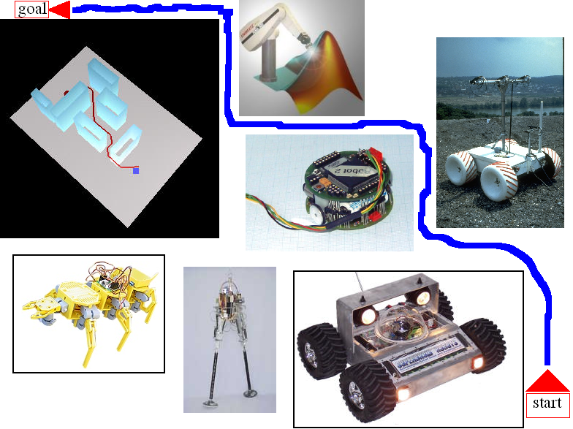
Robot Path Planning
Mustafa İNGÖK
Abdel-Razzak MERHEB

Slide 2
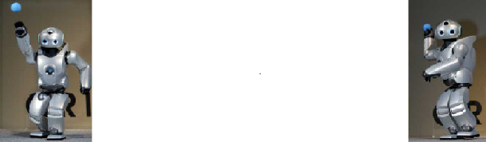
OUTLINE
INTRODUCTION
KHEPERA ROBOT
METHODS USED
OUR ALGORITHMS
RESULTS
CONCLUSION & DISCUSSION

Slide 3
Introduction
Path planning's objective is to find the shortest path or a relatively short path from a starting point to a goal point, avoiding all known obstacles in the area.
Path planning is everything in robotics, the robot is a movable device, and in order to achieve a specific task it should move in a previously decided manner.

Slide 4
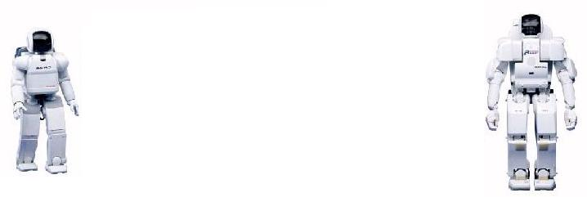
Path Planning
As a human, what do we do before doing anything?
We ask ourselves:
What to do, and how to do...
In robot language:
Where am I going?
How do I get there?

Slide 5
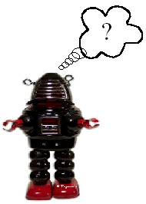
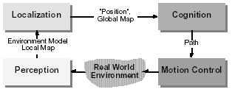

Slide 6

Cognition / Reasoning :
Is the ability to decide what actions are required to achieve a certain goal in a given situation.
Decisions ranging from what path to take to what information on the environment to use.
Has been largely explored in literature for cases in which complete information about the current situation and the environment exists (e.g. sales man problem).

Slide 7
NOTE:
Today’s industrial robots can operate without any cognition (reasoning) because their environment is static and very structured.
In mobile robotics, cognition and reasoning is primarily of geometric nature, such as picking safe path or determining where to go next.

Slide 8
In mobile robotics the knowledge of about the
environment and situation is usually only partially known
and is uncertain. This:
makes the task much more difficult
requires multiple tasks running in parallel, some for planning
(global), some to guarantee “survival of the robot”.
Robot control can usually be decomposed in various behaviors or functions:
wall following, localization, path generation or obstacle
avoidance.

Slide 9
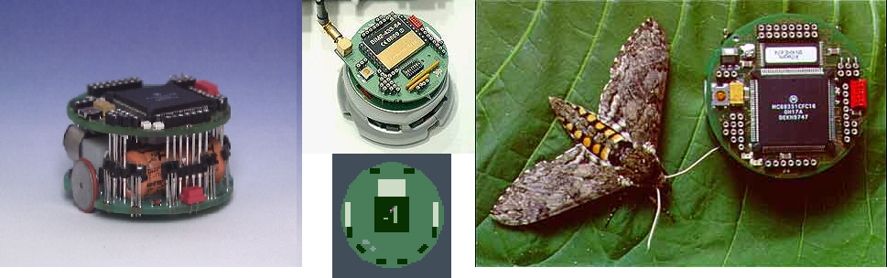
Khepera Robot

Slide 10
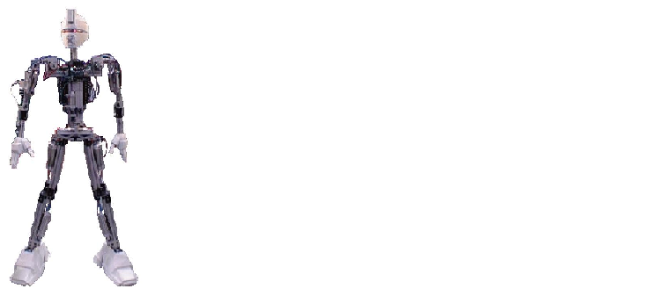
Famous methods in Path Planning
Visibility Graph
Voronoi Diagram
Cell Decomposition
Search strategies
Obstacle Avoidance
And much much more...

Slide 11
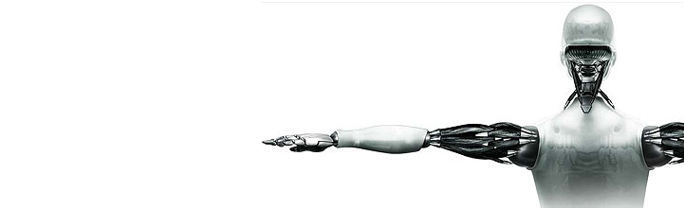
Configuration Space
• Is the set of legal configurations of the robot. It also defines the topology of continuous motions.
• For rigid-object robots
(no joints) with finite
physical size, there exists a transformation
to the robot and obstacles that turns the robot
into a single point: The C-Space Transform.
(see our Demo)

Slide 12
Configuration space
In the configuration space (c-space) approach, a world is modeled as a set of geometric obstacles. Obstacle boundaries are expanded to include the effective radius of a mobile robot. The robot center is then treated as a reference point. The remaining non obstacle free space is considered a legal region to position the mobile robot.

Slide 13
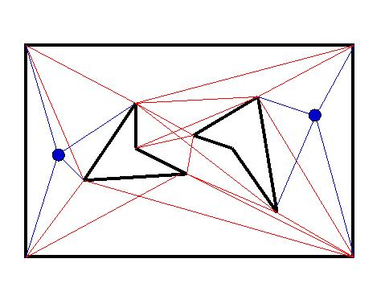
Visibility Graph
After expanding obstacles (with C-space),
Visible tangents are calculated between all obstacles. A fully connected graph is defined by
the obstacle boundaries and
all the tangents between them.
Determination of a shortest
path is accomplished by
searching the visibility graph
for the lowest cost path
between start and goal points.
Polygons are commonly used to
represent obstacles.

Slide 14
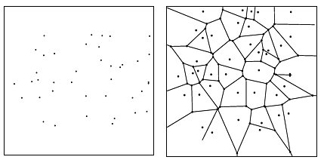
Voronoi Diagram
The edges of the Voronoi diagram define the possible channels that maximize the distance to the obstacles. Thus in planning paths among the sites, it will be ``safest'' to stick to the edges of the Voronoi diagram.

Slide 15
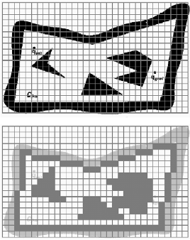
Cell Decomposition

Slide 16
Path/Graph Search Strategies
Typical search strategies are used :
Deapth-First search
Greedy search
A* search
bla bla bla...

Slide 17
Obstacle Avoidance
The goal of the obstacle avoidance algorithms is to avoid collisions with obstacles.
Navigate on a line joining the start and the goal.
When you find an obstacle, Follow along the obstacle to avoid it... Follow always on the left or the right side.

Slide 18
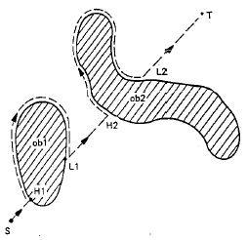
Obstacle Avoidance

Slide 19
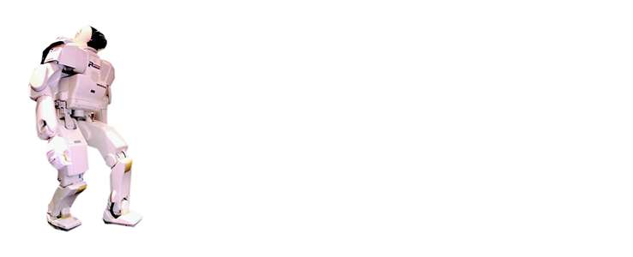
OUR Algorithms
C-Space transformation program
Depth-First search program
Greedy search program
Obstacle-Avoidance program
Voronoi Diagram

Slide 20
C-Space
Actually we used our image processing knowledge in this program.
Using morphological operations we dilate the obstacles.
The structuring element used has the shape of our robot.

Slide 21
Depth-First search
Check one of the directions to the deepest level. Only when you hit a dead end check another direction.
We used the qeue : W,N,E,S

Slide 22
Greedy search
Assume that the coordinates of the goal is known.
The robot check three directions, front-middle, front-right and front-left. It calculates the distance from each of this positions to the goal. The direction giving the minimum distance will be our next position.

Slide 23
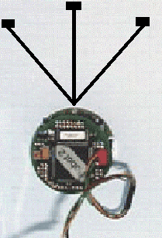
Greedy Search

Slide 24
Obstacle Avoidance
Assuming that we know the coordinates of the goal.
A line is drawn between the start and the goal.
The slope of this line is found.
The robot turn an angle of atan(slope).
The robot start to navigate, it follows each obstacle in order to avoid it.

Slide 25
Voronoi Diagram
Here also we are using image processing.
The map can be entered as a picture.
The centers of the obstacles will be found.
Voronoi diagram is drawn.
A line is drawn from the start to the goal.
Using edge detection, then processing the image we can find the minimum path.

Slide 26
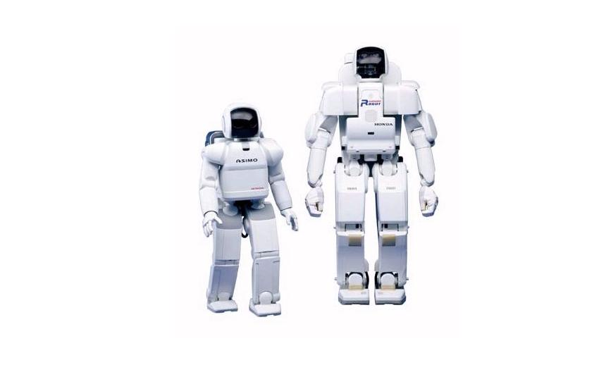
OUR RESULTS

Slide 27
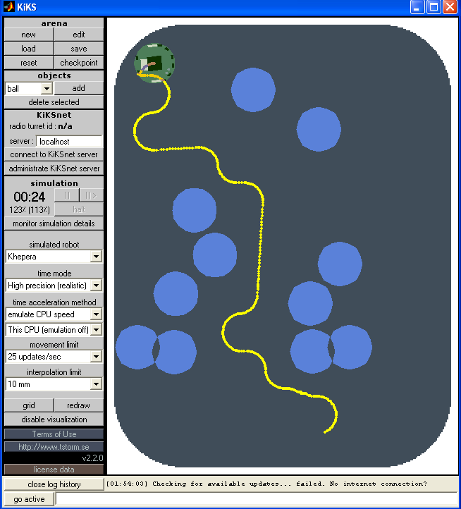
Depth-First search

Slide 28
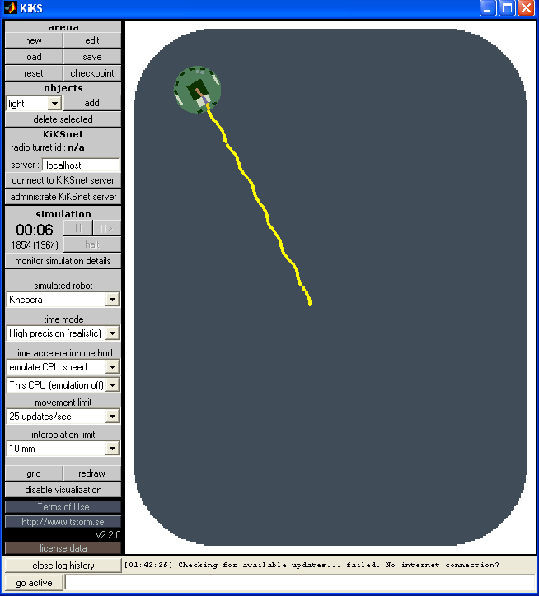
Greedy search

Slide 29
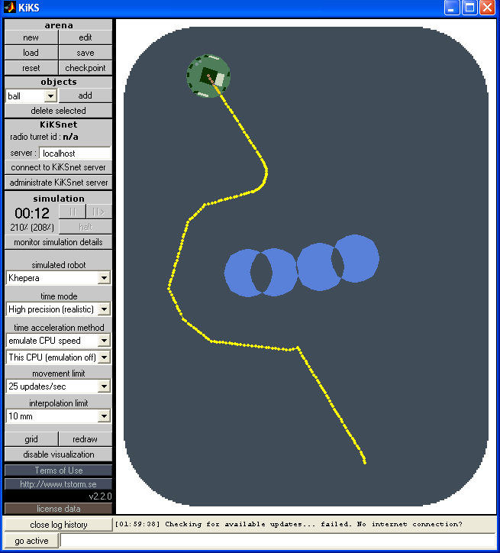
Obstacle Avoidance

Slide 30
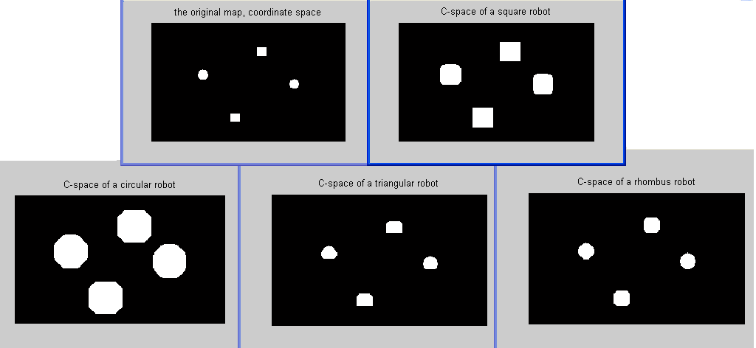
C-Space

Slide 31
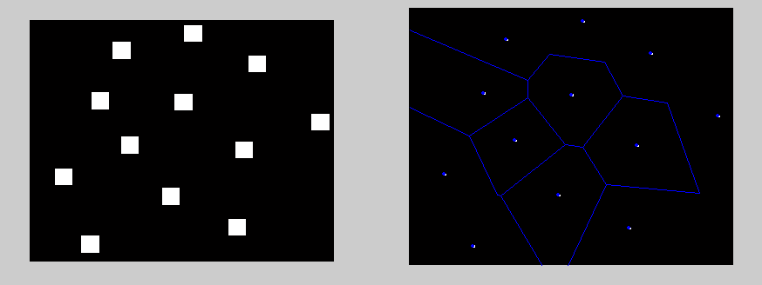
Voronoi Diagram

Slide 32
Conclusion & Discussion
Path Planning is a search problem.
Computational graphic is used as a first step.
Who search find (even with a false algorithm, a robot may find its path).
Without path planning, robotics is transformed to automation.

Slide 33
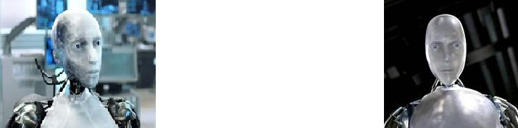
Problems with our programs...

Slide 34
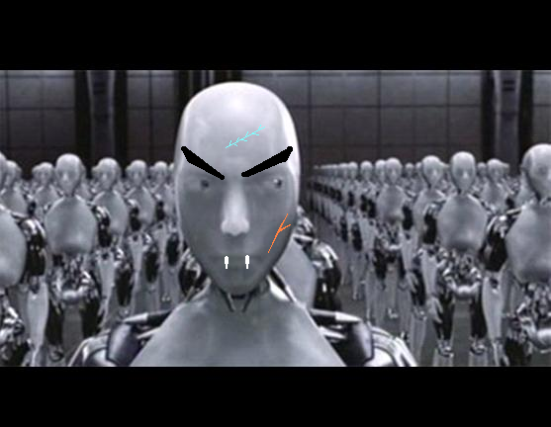
Any Question so far ?!!
Any Question so far ???

